Slide 1


PANIMALAR ENGINEERING COLLEGE
(An Autonomous Institution, Affiliated to Anna University, Chennai)
DEPARTMENT OF COMPUTER SCIENCE AND ENGINEERING
ADVANCED MODEL FOR STOCK PRICE FORECASTING WITH ENHANCED FEATURE ENGINEERING AND ADAPTIVE PARAMETER TUNING
KRITHIKA K : 211421104134
DIVYASHREE D : 211421104322
VAISHNAVI R : 211421104332
Dr. Jackulin
Department of Computer Science and Engineering College,
Panimalar Engineering College,
Chennai , Tamil Nadu , India
Dr. Kavitha Subramani
Department of Computer Science and Engineering College
Panimalar Engineering College , Chennai, Tamil Nadu , India

Slide 2
ABSTRACT
The stock market plays a great role in the capital market, which can promote capital flow, optimize asset allocation, and stimulate better and faster economic development. At the same time, the stock market is a remarkable place for investors to invest and a focal point for the state to regulate economic trends. Investors are more concerned about how to maximize profits while minimizing risks, and the state is always alert to the occurrence of economic cries.

Slide 3
INTRODUCTION
The stock market plays a great role in the capital market , which can promote capital flow , optimize asset allocation ,and stimulate better and faster economic development. At work same time , the stock market is the remarkable place for investors to invest and focal point for the state to regulate economic trends. Investors and more concerned about how to maximize profits while minimizing risks , and the state is urgently need to make accurate judgements on the stock price trend . with the continuous development of the internet in the financial industry , the stock market has generated a large amount of network data. Due to the sensitivity of the stock amount of data network. Due to the sensitivity of the stock market to various factors , its difficult to draw accurate and valid conclusions from these massive stored data . In Addition , financial time series and characterized by instability , nonlinearity , noise. Attach the great importance to study in depth. The stock market is also an exceptionally complex non linear dynamic system.

Slide 4
OBJECTIVE OF THE PROJECT
The Aim of the project is to examine a number of different forecasting techniques to predict future stock returns based on past returns and numerical new indicators to construct a portfolio of multiple stocks in order to diversify the risk.

Slide 5
Literature survey
PAPER TITLE | AUTHORS | YEAR | METHODOLOGY | KEY FINDINGS
Stock prediction using LSTM network | Sharma et al | 2020 | LSTM | Achieved higher accuracy that traditional method
Sentiment analysis for stock prediction | Johnson et al | 2021 | NLP | Showed a positive correlation between market sentiment and price movements
Hybrid model for stock forecasting | Brown et al | 2022 | HYBRID(LSTM + ARIMA) | Improved predictive power through model combination

Slide 6
PAPER TITLE | AUTHORS | YEAR | METHODOLOGY | KEY FINDINGS
Financial news impact on stock prices | Davis et al | 2023 | EVENT STUDY | News events significantly influence short term price volatility
The role of technical indicators | Miller et al | 2025 | SVR | SVR offers reasonably accurate volatile forecasting

Slide 7
PROBLEM STATEMENT
Existing hybrid stock prediction models while effective to a degree, face several challenges like;
Lack of External Factor Integration : Many models primarily focus on historical price data and ignore other potentially influential factors like sentiment , news , event, and economic indicators.

Slide 8
PROPOSED SYSTEM
This project develops an intelligent stock price prediction system, integrating data acquisition, advanced modeling, and interactive visualization.
The system utilizes finance library to collect real-time and historical stock market data, which is then preprocessed for model training.
Advanced deep learning models, including sophisticated LSTM networks and ARIMA models, are employed to capture complex temporal dependencies and forecast future stock prices.
These models are rigorously trained and evaluated using appropriate metrics. A user-friendly web application, built with Flask or Django, HTML, CSS, and JavaScript, allows users to input stock tickers and visualize predicted prices, future trends, and model performance comparisons through interactive charts.
The system aims to provide a practical tool for stock market analysis and forecasting.
By combining advanced algorithms with a user-friendly interface, this project seeks to enhance the accuracy and accessibility of stock price predictions.
The interactive visualizations empower users to make informed investment decisions.
This integrated approach represents a significant advancement in stock market forecasting The outcomes of this research contribute to improved drought preparedness and management strategies, enabling stakeholders to make informed decisions and mitigate the adverse effects of droughts in vulnerable regions.

Slide 9
SOFTWARE AND HARDWARE USED
SOFTWARE REQUIREMENTS:
Operating System : Windows 7 , 8, 10 (64 bit)
Software : Python 3.7
Tools : Anaconda (Jupyter Note Book IDE)
Framework : Flask or Django
HARDWARE REQUIREMENTS:
Hard Disk : 500GB and Above
RAM : 4GB and Above
Processor : I3 and Above

Slide 10
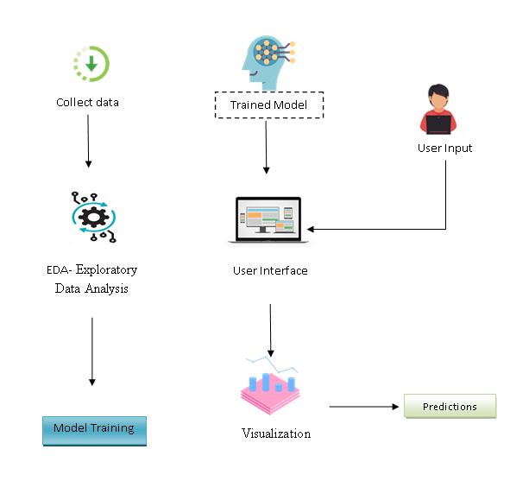
ARCHITECTURE / METHODOLOGY

Slide 11
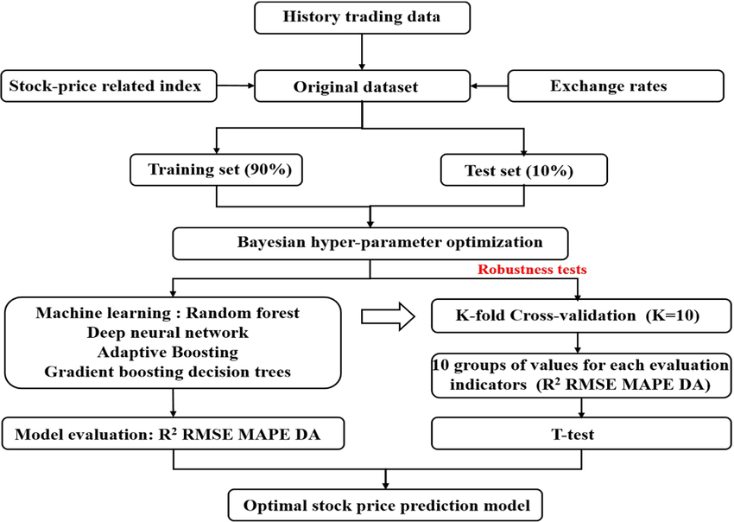
SYSTEM DESIGN – FLOW CHART / DFD / ER

Slide 12
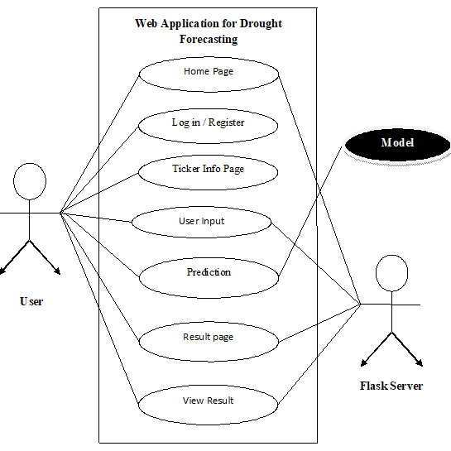
Use case diagram :

Slide 13
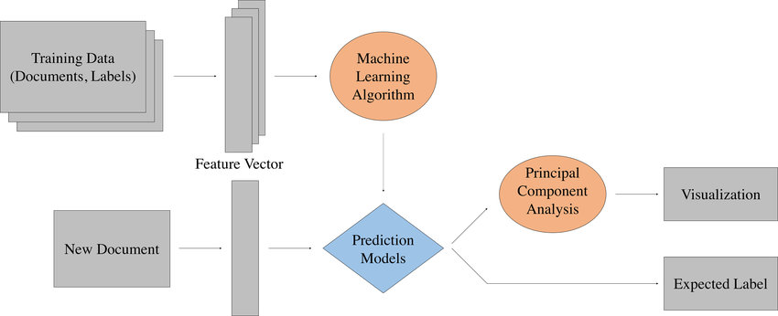
DFD DIAGRAM :

Slide 14
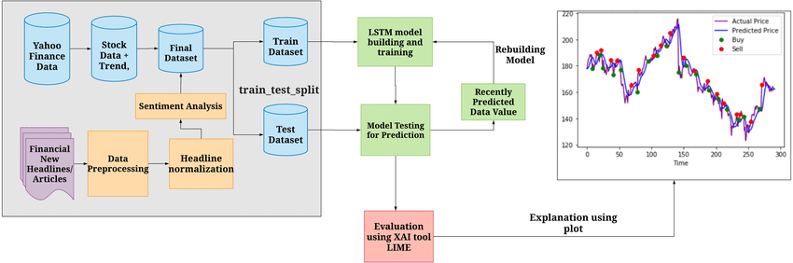
ER DIAGRAM :

Slide 15
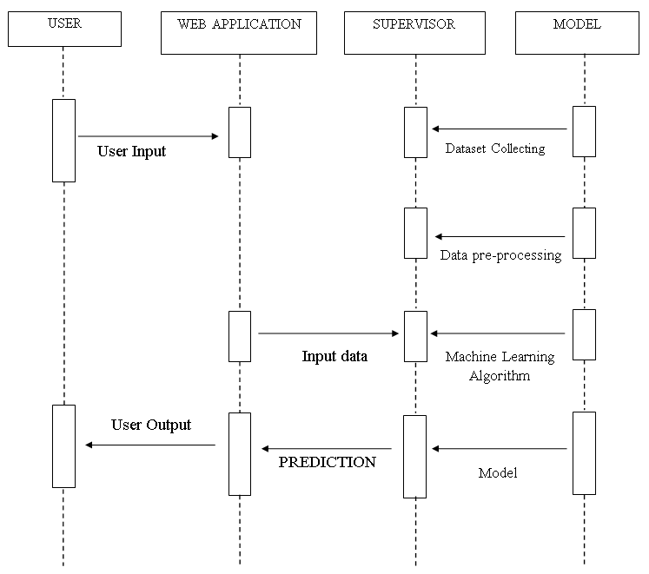
SEQUENCE DIAGRAM :

Slide 16
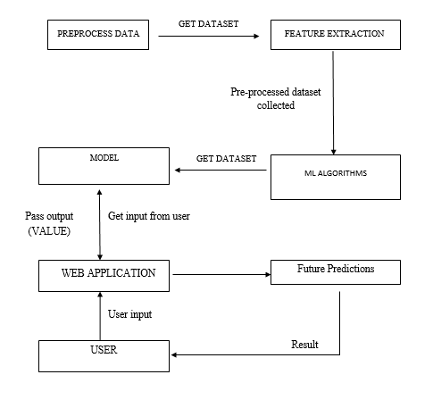
COLLABORATION DIAGRAM :

Slide 17
MODULE DESCRIPTION
Stock price prediction using machine learning involves using algorithms to analyze historical data and market trends to forecast future stock prices, offering insights for investors and financial institutions.
Here's a more detailed explanation :
What is Stock Price Prediction ?
Forecasting Future Prices:
Stock price prediction aims to determine the potential future value of a company's stock or other financial assets traded on a market.
Data Analysis:
It involves analyzing historical stock data, market indicators, and other relevant information to identify patterns and trends that can be used to predict future price movements.

Slide 18
Machine Learning Algorithms:
Machine learning algorithms, such as regression, classification, and time series models, are used to build predictive models that can forecast stock price.
Benefits:
Accurate stock price prediction can help investors make informed decisions, optimize portfolios, and potentially increase profits.
2. How Machine Learning is Used in Stock Price Prediction ?
Data Collection and Preprocessing:
Gathering historical stock data, including opening, closing, high, low prices, and trading volume.
Cleaning and preparing the data for analysis, including handling missing values and outliers.

Slide 19
Feature Engineering:
Creating new features from existing data, such as technical indicators (e.g. moving averages, RSI).
Identifying relevant variables that can influence stock prices.
Model Training:
Training machine learning models on historical data to learn patterns and relationships.
Commonly used algorithms include:
Regression Models: (e.g., Linear Regression, Support Vector Regression) for predicting continuous values like stock prices.
Classification Models: (e.g., Random Forest, Support Vector Machines) for predicting price direction (up or down).
Time Series Models: (e.g., ARIMA, LSTM) for capturing sequential patterns in stock prices.

Slide 20
Model Evaluation:
Evaluating the performance of the trained models using metrics like Mean Squared Error (MSE) or Root Mean Squared Error (RMSE).
Comparing the predicted values with actual values to assess accuracy.
Prediction and Application:
Using the trained models to predict future stock prices.
Applying the predictions to develop trading strategies or make investment decisions.

Slide 21
Challenges in Stock Price Prediction
Volatility and Randomness:
Stock markets are highly volatile and unpredictable, making accurate prediction challenging.
Data Availability and Quality:
The availability and quality of historical data can impact the performance of machine learning models.
Overfitting:
Machine learning models can overfit the training data, leading to poor performance on unseen data.
External Factors:
Stock prices are influenced by various external factors, such as economic news, political events, and social media trends, which can be difficult to incorporate into models.

Slide 22
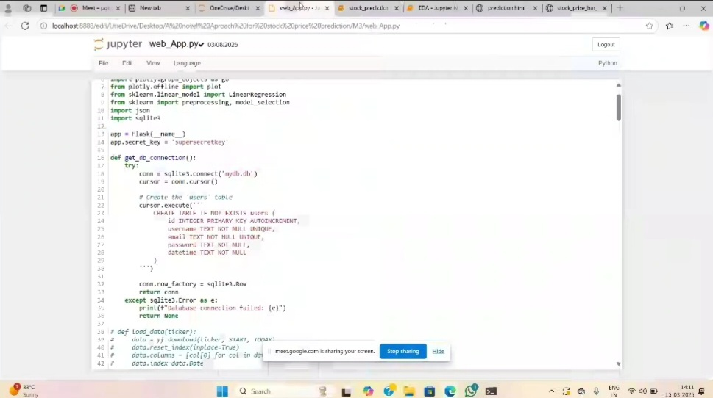
TESTING / PERFORMANCE EVALUATION /RESULTS

Slide 23
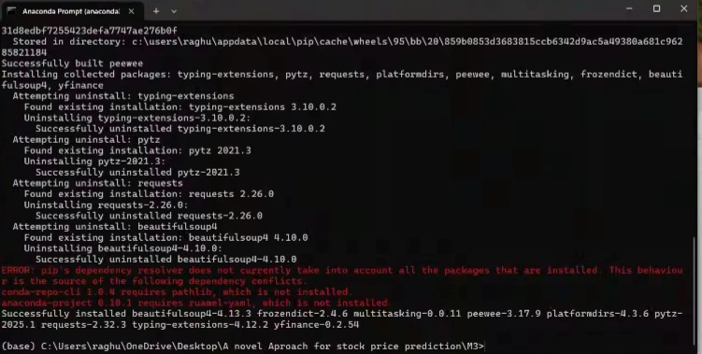

Slide 24
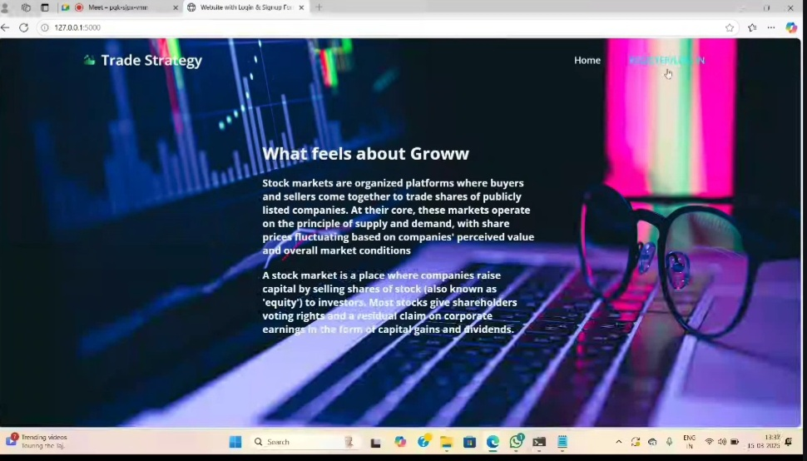
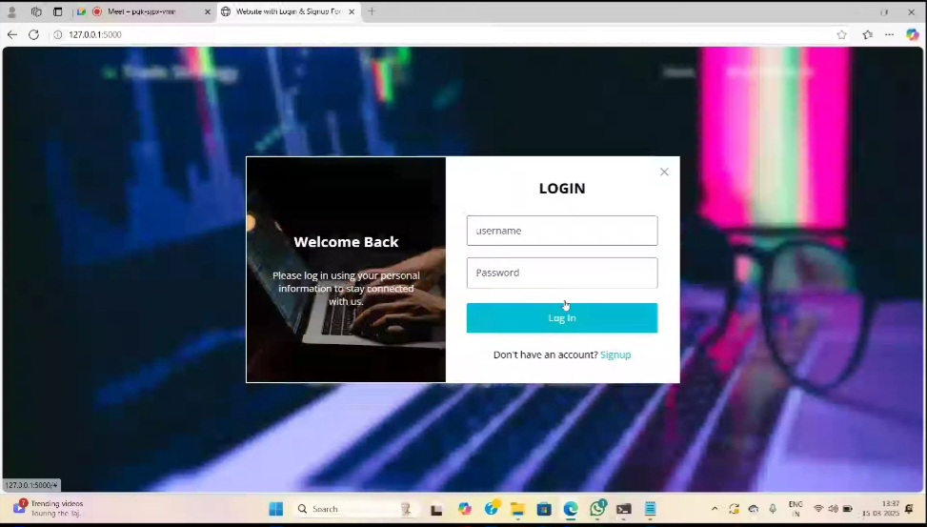
RESULT :

Slide 25
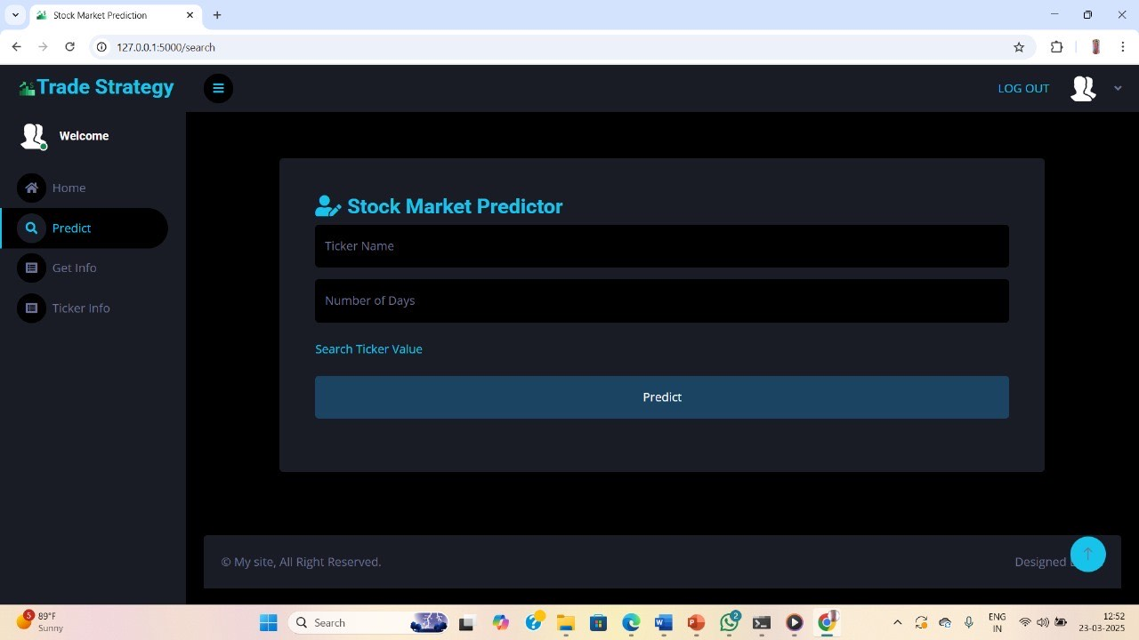
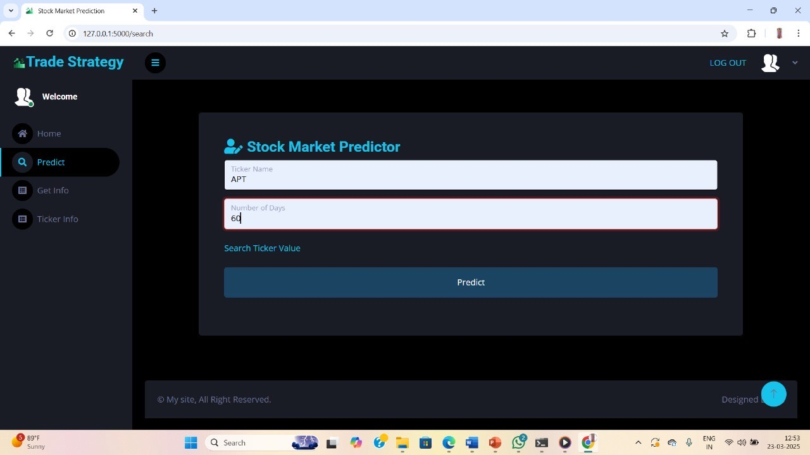

Slide 26
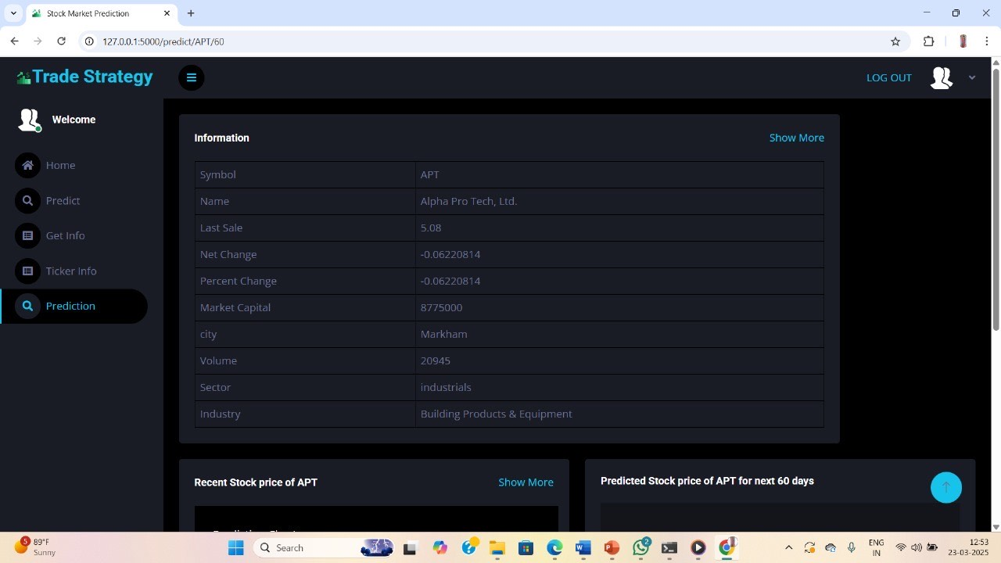
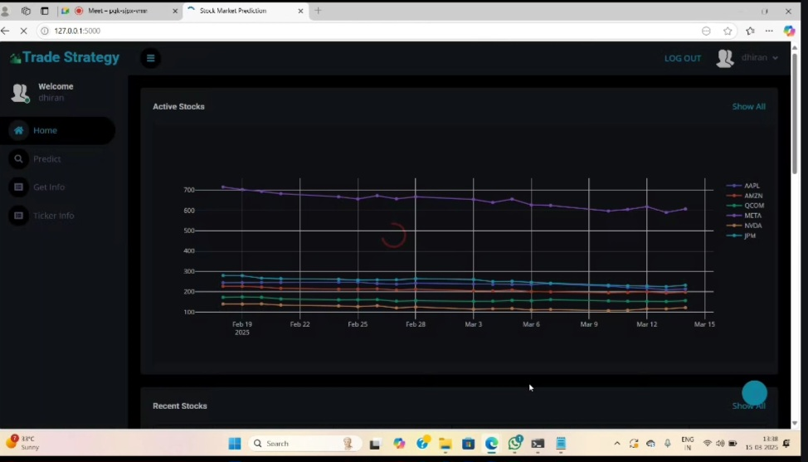
FINAL RESULT :

Slide 27
CONCLUSION
This project successfully developed an intelligent stock price prediction system that integrates advanced deep learning and time series analysis techniques with a user-friendly web application. By leveraging the finance library for efficient data acquisition and employing sophisticated LSTM networks and ARIMA models, the system effectively captures complex temporal dependencies in stock market data.

Slide 28
FEATURE ENHANCEMENT :
The stock market is known for being volatile, dynamic, and nonlinear. Accurate stock price prediction is extremely challenging because of multiple (macro and micro) factors, such as politics, global economic conditions, unexpected events, a company’s financial performance, and so on.
But all of this also means that there’s a lot of data to find patterns in. So, financial analysts, researchers, and data scientists keep exploring analytics techniques to detect stock market trends. This gave rise to the concept of algorithmic trading, which uses automated, pre-programmed trading strategies to execute orders.
In this article, we’ll be using both traditional quantitative finance methodology and machine learning algorithms to predict stock movements. We’ll go through the following topics:
Stock analysis: fundamental vs. technical analysis
Stock prices as time-series data and related concepts
Predicting stock prices with Moving Average techniques
Introduction to LSTMs
Predicting stock prices with an LSTM model
Final thoughts on new methodologies, such as ESN

Slide 29
REFERENCES :
[1] S. Aghabozorgi and Y. W. Teh, ‘‘Stock market co-movement assessment
using a three-phase clustering method,’’ Expert Syst. Appl., vol. 41, no. 4,pp.
1301–1314, Mar. 2014.
[2] D. E. Allen, M. McAleer, and A. K. Singh, ‘‘Daily market news sentiment
and stock prices,’’ Appl. Econ., vol. 51, no. 30, pp. 3212–3235, Jun. 2019.
[3] S. Asadi, E. Hadavandi, F. Mehmanpazir, and M. M. Nakhostin,
‘‘Hybridization of evolutionary Levenberg–Marquardt neural networks
and data pre-processing for stock market prediction,’’ Knowl.-Based Syst.,
vol. 35, pp. 245–258, Nov. 2012.
[4] A. Azhikodan, A. G. K. Bhat, and M. V. Jadhav, ‘‘Stock trading bot using
deep reinforcement learning,’’ in Innovations in Computer Science and
Engineering. Singapore: Springer, 2019, pp. 41–49.
[5] R. Batra and S. M. Daudpota, ‘‘Integrating StockTwits with sentiment
analysis for better prediction of stock price movement,’’ in Proc. Int. Conf.
Comput., Math. Eng. Technol., Jan. 2018, pp. 1–5.
[6] V. Boginski, S. Butenko, and P. M. Pardalos, ‘‘Statistical analysis
of financial networks,’’ Comput. Statist. Data Anal., vol. 48, no. 2,
pp. 431–443, Feb. 2005. [Online]. Available: http://www.sciencedirect.
com/science/article/pii/S0167947304000258
[7] V. Boginski, S. Butenko, and P. M. Pardalos, ‘‘Mining market data:
A network approach,’’ Comput. Oper. Res., vol. 33, no. 11, pp. 3171–3184,
Nov. 2006.

Slide 30
[8] P. J. Bolland and J. T. Connor, ‘‘A constrained neural network Kalman filter
for price estimation in high frequency financial data,’’ Int. J. Neural Syst.,
vol. 8, no. 4, pp. 399–415, Aug. 1997.
[9] J. Bollen, H. Mao, and X. Zeng, ‘‘Twitter mood predicts the stock market,’’
J. Computer. Sci., vol. 2, no. 1, pp. 1–8, Mar. 2011. [Online]. Available:
http://www.sciencedirect.com/science/article/pii/S187775031100007X
[10] A. Booth, E. Gerding, and F. McGroarty, ‘‘Automated trading with
performance weighted random forests and seasonality,’’ Expert Syst. Appl.,
vol. 41, no. 8, pp. 3651–3661, Jun. 2014.
[11] R. C. Cavalcante, R. C. Brasileiro, V. L. F. Souza, J. P. Nobrega,
and A. L. I. Oliveira, ‘‘Computational intelligence and financial markets:
A survey and future directions,’’ Expert Syst. Appl., vol. 55, pp. 194–211,
Aug. 2016.
[12] M. Chang. (2018). How A.I. Traders Will Dominate Hedge Fund Industry.
[Online]. Available: https://www.youtube.com/watch?v=lzaBbQKUtAA
[13] T.-J. Chang, N. Meade, J. E. Beasley, and Y. M. Sharaiha, ‘‘Heuris-
tics for cardinality constrained portfolio optimisation,’’ Comput. Oper.
URL : https://ieeexplore.ieee.org/stamp/stamp.jsp?arnumber=9350582
https://ieeexplore.ieee.org/stamp/stamp.jsp?arnumber=10309124
https://ieeexplore.ieee.org/stamp/stamp.jsp?arnumber=10528270

Slide 31
Conference / Publication / Patent Certificate/ Project Contest Winner Certificates
Conference Name: 2025 2nd International Conference on Computing and Data Science (ICCDS)
Paper ID: 282
Conference Name: 15TH INTERNATIONAL CONFERENCE ON SCIENCE AND INNOVATIVE ENGINEERING -15 ICSIE 2025
Paper ID: ICSIE251181

Slide 32
Thank You

